Slide 1
EFFECTIVE COACHING
Internal Training
Kudo
Jakarta, 16 March 2017

Slide 2

About Me
Education Background:
Industrial Engineering (S1,S2)
National Taiwan University of Science & Technology
Bandung Institute of Technology
Work Experiences:
PT. TIKI JNE
Vice President Human Capital (Sep 2015 – Nov 2016)
Head of Human Capital (Dec 2011 – Aug 2015)
Head of Research & Analysis (Jan – Des 2011)
Technical Advisor of Research & Analysis (Sep – Des 2010)
PT. LAPI ITB
Associate HR Consultant (2008 – 2009)
EDULAB INDONESIA
Co-founder, HR Manager (2007-2008)
Achievement:
Initiating and leading HC process transformation in JNE
The youngest Top Management Team of JNE Holding (2015-2016)
Stellar Workplace Award (2016)
HC Excellence: Recruitment & Attraction (2016)
Asia HR Award: Organization by SMR Group, Malaysia (2014)
Best Workplace in Women Empowerment (2014)
Indonesia Human Capital Future Leader by SWA (2013)
Kartika Akbaria (Tika)
Head of Human Capital
PT. Kudo Teknologi Indonesia
k.akbaria@gmail.com
+62 812 2008 4066
IG: @k.akbaria
Mother of one
Travel, violin, piano

Slide 3

Rule #1 OPEN MIND
Notes:
Rule #1: Open Mind

Slide 4

Rule #2 ACTIVE PARTICIPATION
Notes:
Rule #2: Active Participation

Slide 5
Effective Coaching
Learning Objectives
Understand the distinctive roles as manager and leader.
Understand interaction essentials used to lead effectively and successfully.
Understand two types of needs during interaction with sub-ordinates.
Understand definition, types, and techniques of effective coaching to boost peak performance.
Performance Objectives
Act as leader and manager properly.
Improve the quality and effectiveness of communication between leader and his/her team.
Set 1o1 coaching periodically.
Improve collaboration and empowerment within team.

Slide 6
LEADER VS MANAGER
PERSONAL NEEDS
PRACTICAL NEEDS
The “human” needs that people bring to their work and to an interaction
The objectives to be accomplished through an interaction.

Slide 7
Key Principles (to meet personal needs)
ESTEEM
Maintain or enhance self-esteem.
Listen and respond with empathy.
EMPATHY
Ask for help and encourage involvement.
INVOLVEMENT
Share thoughts, feelings, and rationale. (to build trust)
SHARE
Provide support without removing responsibility.
(to build ownership)
SUPPORT
7

Slide 8

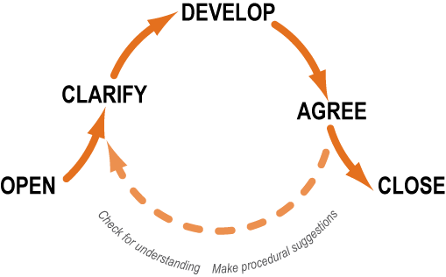
Interaction Essentials (to meet personal and practical needs)
Esteem
Empathy
Involvement
Share
Support

Slide 9
Coaching means . . .
Providing timely guidance and feedback to help others strengthen the specific skills, knowledge areas, or behaviors needed to accomplish a task or solve a problem.

Slide 10
Types of Coaching
Guiding people toward success in new or challenging situations
Proactive Coaching
Guiding people in improving or enhancing work performance
Reactive Coaching
Guiding people in improving or enhancing work performance along with formal punishment
Serious Performance Problems

Slide 11
Discuss, then debate!
Proactive Coaching Team
Proactive coaching has a greater impact on people, productivity, and profitability than reactive coaching because ____________.
Reactive Coaching Team
Reactive coaching has a greater impact on people, productivity, and profitability than proactive coaching because ____________.

Slide 12
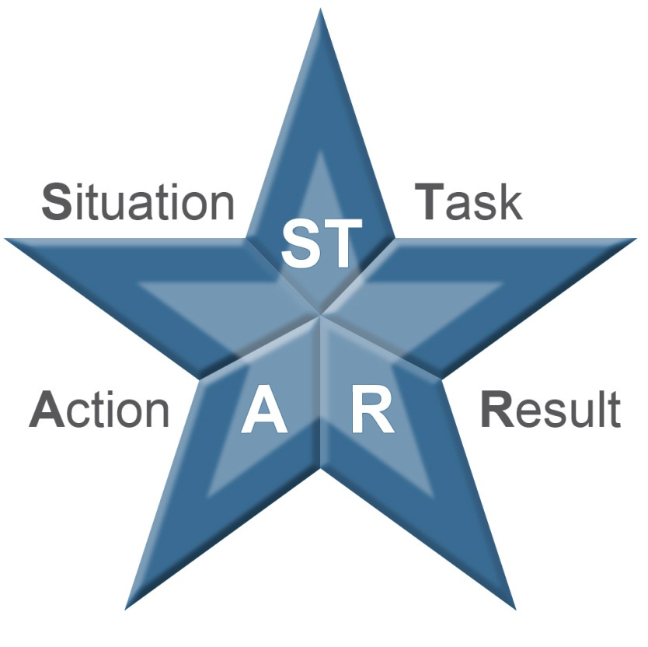
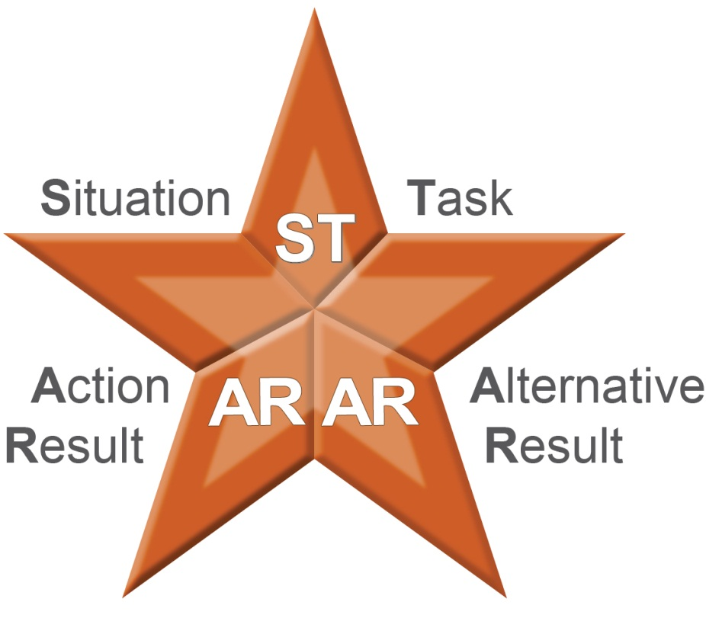
Effective Feedback

Slide 13

Coaching Process
Identify Need
Observe performance
Measure results
coach
Day-to-day feedback
Formal discussion
Provide support
Encourage responsibility
Provide resources
Remove barriers

Slide 14



Coaching Techniques
Seek and Leverage Data
Balance Seeking and Telling
Provide Ongoing Feedback and Support

Slide 15
Learning Stations
Answer questions at your assigned station. (5 minutes)
Rotate to next station (2 minutes each):
Review responses and check (✓) those you agree with.
Add additional insights.
Mark where you are on each continuum.

Slide 16
Skill Practice Process
2 Roles
Skill user
Skill partner + observer

Slide 17
Feedback
Ask skill users to describe:
What they did well.
What they could have done more effectively.
What they would do differently next time.
Share feedback.
Ask skill partners to share how they felt about the discussion and any additional observations.

Slide 18
First, to be a leader, you must be YOURSELF.
Followers want to be led by a PERSON,
not a role holder or a position filler.
- Rob Goffee & Gareth Jones-

Slide 19
Reference
JNE Leadership Program
Effective Coaching, Daya Dimensi Indonesia

Slide 20


